Slide 1
Case Study on Article Popularity Prediction
BY
MIDUTHURU KARTHIK
Reg.no:19225760028

Slide 2
Problem Statement
Mashable is a global, multi – platform media and entertainment company.
Just like any other media company its success depends on the popularity of articles.
One of the key metrics to measure popularity is number of shares done on the article.
The goal is to do analysis and modelling to predict the number of shares of an article given the input parameters

Slide 3
Defining the Problem
Article popularity is one of key aspects of the online content.
The more the shares the more it will be popular and which will increase the traffic of their website which intern helps in improving the revenue.
Analysing which type of articles are becoming popular and predicting them before publishing will help the company to improve the content.

Slide 4
Dataset
The data is collected over the period of few years and mashable has collected data on around 40,000 articles. The dataset contains 61 columns including the target variable i.e. shares
Since the target variable has large variance I am classifying the column into 3 levels i.e. unpopular(0),popular(1),very popular(2).
Unpopular-shares less than 50 percentile value.
Popular-shares between 50 percentile to 75 percentile value.
Very popular-shares greater than 75 percentile value.

Slide 5
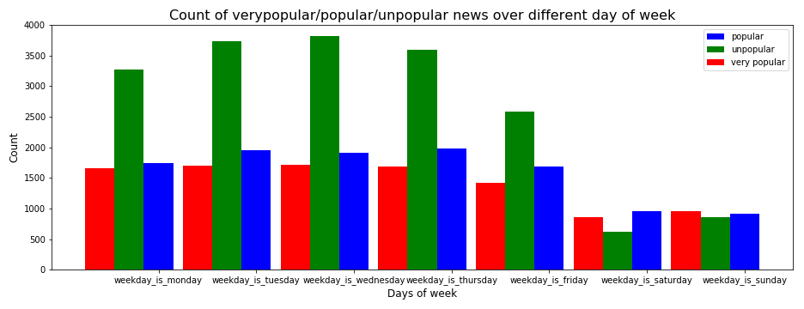
Count of very popular/popular/unpopular news over different day of week.
1)More number of articles got published during weekdays 2)On Wednesday more number of articles got published 3)On weekends less number of articles got published

Slide 6
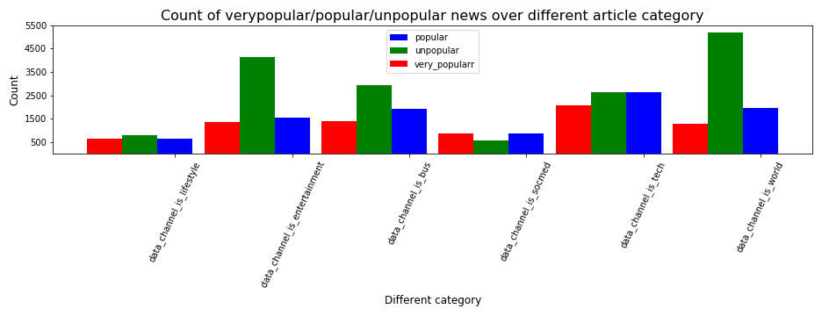
Count of very popular/popular/unpopular news over different article category
1)Technology is most popular article category 2)Next best categories are business and world 3)Least popular is social media

Slide 7
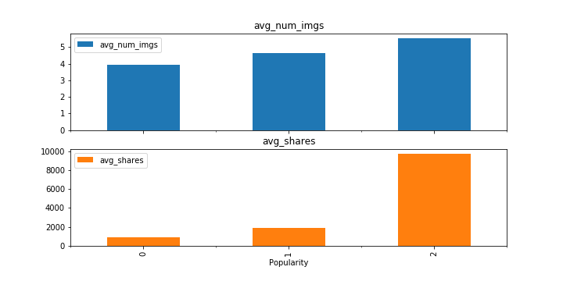
Average num_imgs vs Average shares
If there are more images then the article has high chance to be more popular.

Slide 8
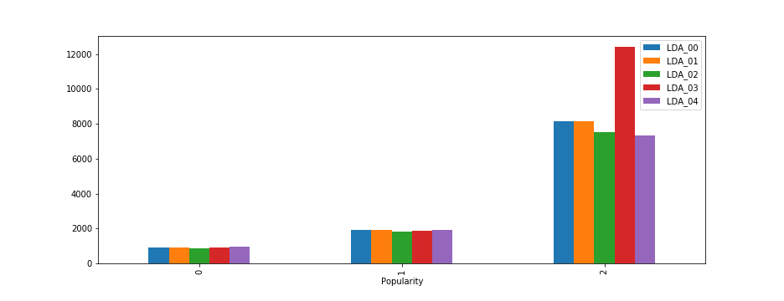
Latent Dirichlet allocation
1)LDA is a form of unsupervised learning that views documents as bags of words. It's a way of automatically discovering topics that sentences contain. 2)We will check if publishing articles close to LDA topic leads to more shares.3)From the analysis we can see that publishing articles which are close to LDA topics will be more popular.

Slide 9
Machine Learning Models
Logistic Regression:
The accuracy score for logistic regression with 80,20 split of data is 91.8%.
Random Forest Classifier:
With best parameters from grid search the accuracy of the model is 94.17%.

Slide 10
Ways to improve article popularity
1.Try to publish articles which are close to LDA topics.
2.Publish more articles during weekdays as they are more popular.
3.Try to publish more articles of the topic Tech and Business as they are popular.
4.Articles having images are popular so publish articles with some images.
5.In weekends try to increase publishing articles of categories Tech,Business so that articles can become popular.

Slide 11
Thank you

